Slide 1
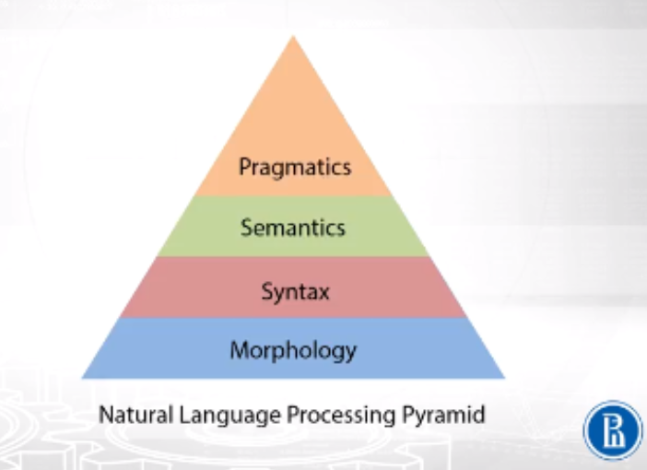

Slide 2
Morphological/Lexical Analysis

Slide 3
The term morphological analysis is related to the parsing of morphemes.
Morphological parsing as the problem of recognizing that a word breaks down into smaller meaningful units called morphemes producing some sort of linguistic structure for it.
For example, we can break the word foxes into two morphemes, fox and -es.
Morphology is the study of −
The formation of words.
The origin of the words.
Grammatical forms of the words.
Use of prefixes and suffixes in the formation of words.
How parts-of-speech (PoS) of a language are formed.

Slide 4
Types of Morphemes
Morphemes, the smallest meaning-bearing units, can be divided into two types −
Free morphemes (stem)
Can stand alone as words
Eg : she walks – she and walks are free morphemes
Bound morphemes
Cannot stand alone
Eg: unhappiness – un is a bound morphemes

Slide 5
Process to extract morphemes
Stemming
Lemmetization

Slide 6
Syntactic Analysis

Slide 7
Syntactic analysis or parsing or syntax analysis is the second phase of NLP.
The purpose of this phase is to draw exact meaning.
Dictionary meaning from the text.
Syntax analysis checks the text for meaningfulness comparing to the rules of formal grammar.
For example, the sentence like “hot ice-cream” would be rejected by semantic analyzer.
In this sense, syntactic analysis or parsing may be defined as the process of analyzing the strings of symbols in natural language conforming to the rules of formal grammar.
The origin of the word ‘parsing’ is from Latin word ‘pars’ which means ‘part’.

Slide 8
Concept of Grammar
Grammar is very essential and important to describe the syntactic structure of well-formed programs.
Linguistics have attempted to define grammars since the inception of natural languages like English, Hindi, etc.
The theory of formal languages is also applicable in the fields of Computer Science mainly in programming languages and data structure.
For example, in ‘C’ language, the precise grammar rules state how functions are made from lists and statements.

Slide 9
Grammar
S -> NP VP NP -> ART N NP -> ART ADJ N VP -> V VP -> V NP
Lexicon
cried : V dogs: N, V the: ART old: ADJ, N man: N, V
"The dogs cried"
(S (NP (ART the) (N dogs)) (VP cried))
"The old man cried"
(S (NP (ART the) (ADJ old) (N man)) (VP cried))

Slide 10
Types of Parsing
Derivation divides parsing into the followings two types −
Top-down Parsing
Bottom-up Parsing
CYK algorithm

Slide 11
Top-down Parsing
The parser starts constructing the parse tree from the start symbol and then tries to transform the start symbol to the input.
The most common form of top-down parsing uses recursive procedure to process the input.
The main disadvantage of recursive descent parsing is backtracking.
Bottom-up Parsing
The parser starts with the input symbol and tries to construct the parser tree up to the start symbol.

Slide 12
Phrase Structure or Constituency Grammar
Phrase structure grammar, introduced by Noam Chomsky, is based on the constituency relation.
That is why it is also called constituency grammar.
It is opposite to dependency grammar.
The fundamental points about constituency grammar and constituency relation.
All the related frameworks view the sentence structure in terms of constituency relation.
The constituency relation is derived from the subject-predicate division of Latin as well as Greek grammar.
The basic clause structure is understood in terms of noun phrase NP and verb phrase VP.

Slide 13
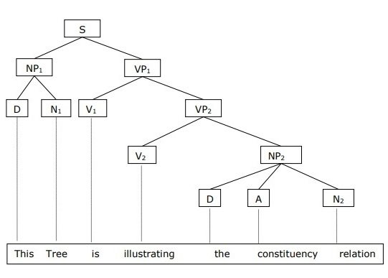
We can write the sentence “This tree is illustrating the constituency relation”

Slide 14
Dependency Grammar
It is opposite to the constituency grammar.
Based on dependency relation.
It was introduced by Lucien Tesniere.
Dependency grammar (DG) is opposite to the constituency grammar because it lacks phrasal nodes.
Fundamental points about Dependency grammar and Dependency relation.
In DG, the linguistic units, i.e., words are connected to each other by directed links.
The verb becomes the center of the clause structure.
Every other syntactic units are connected to the verb in terms of directed link.
These syntactic units are called dependencies.

Slide 15
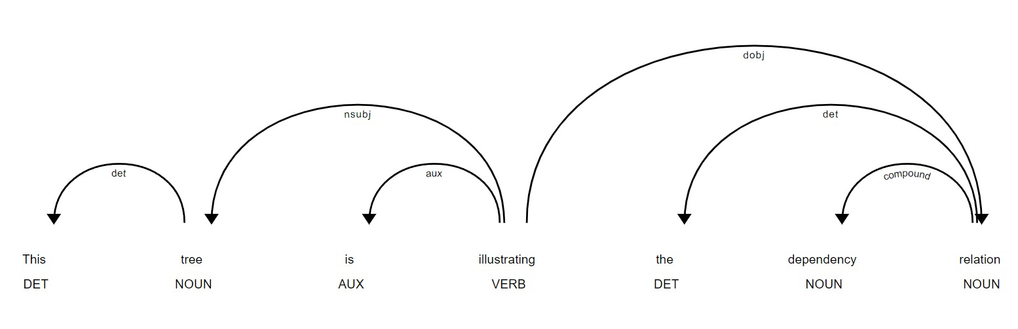
“This tree is illustrating the dependency relation”
Parse tree that uses Constituency grammar is called constituency-based parse tree;
The parse trees that uses dependency grammar is called dependency-based parse tree.

Slide 16
POS TAGGING

Slide 17
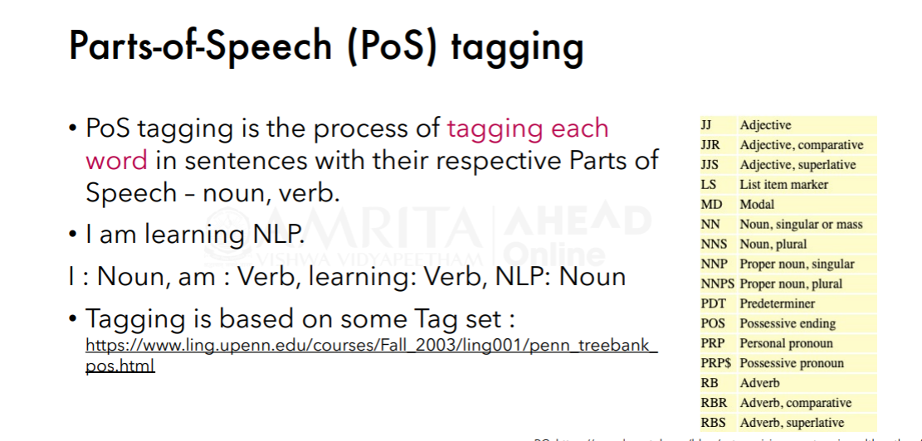

Slide 18
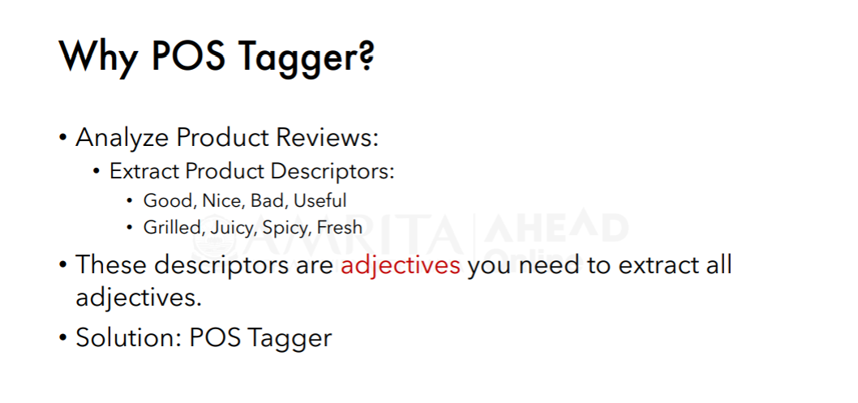

Slide 19
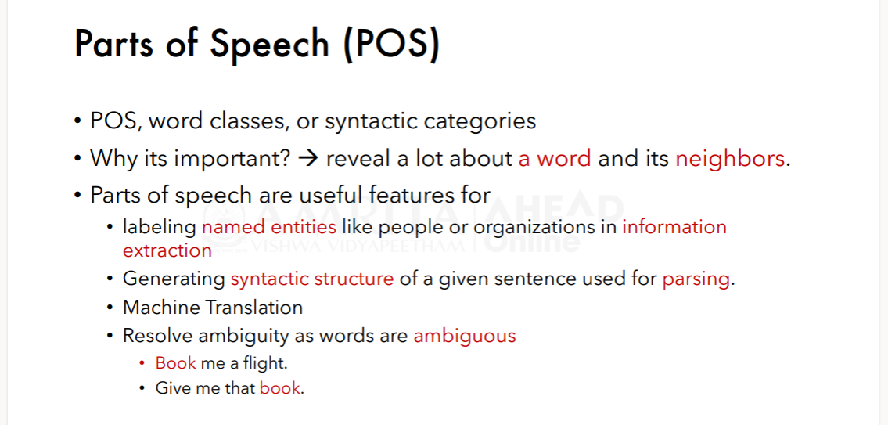

Slide 20
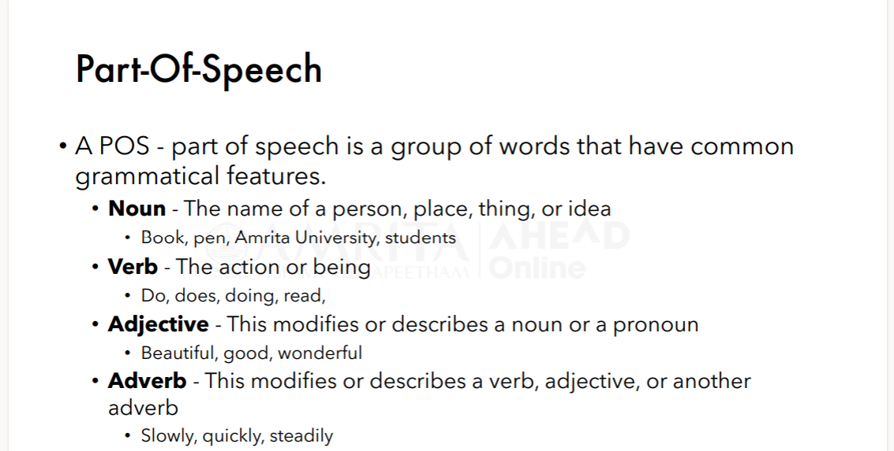

Slide 21
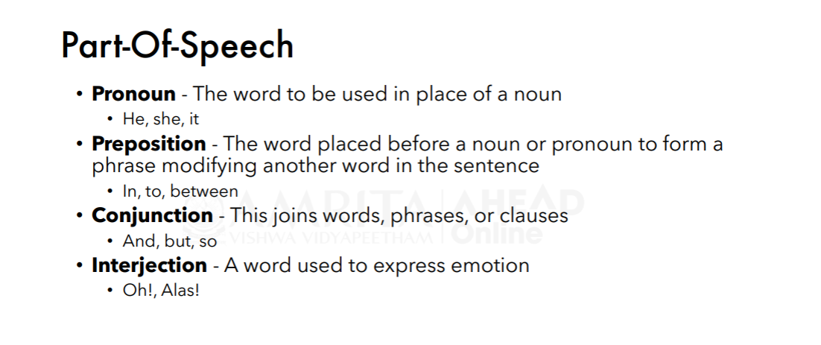

Slide 22
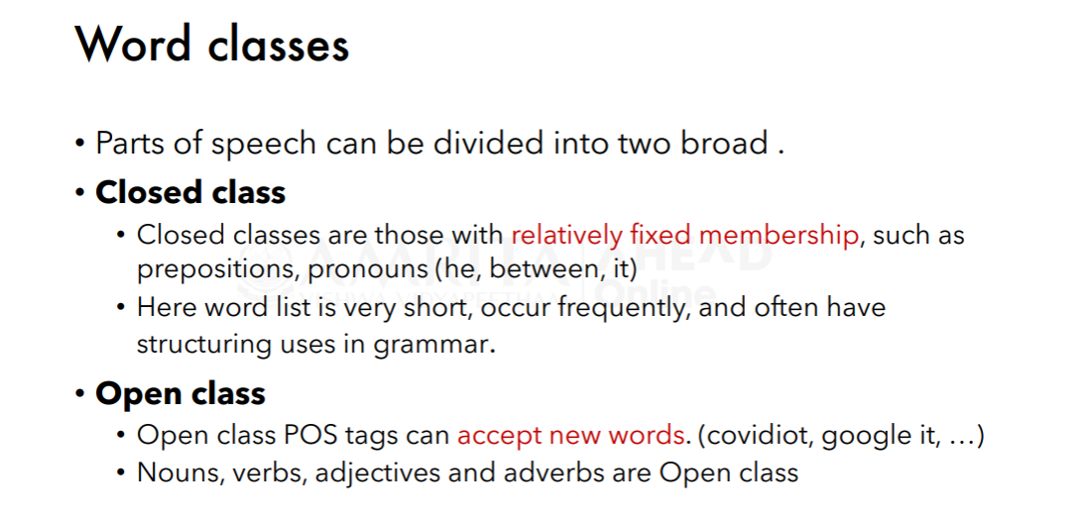

Slide 23
POS TAGGER

Slide 24
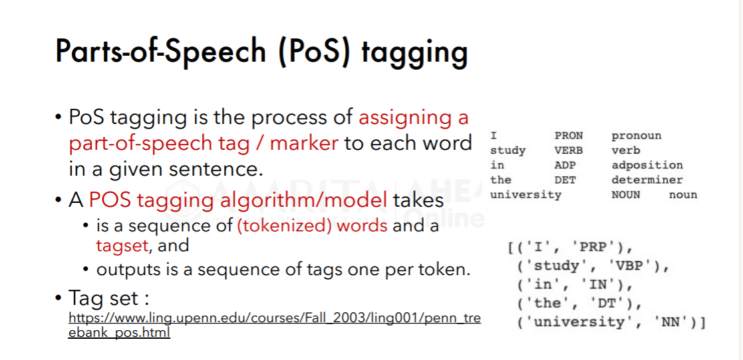

Slide 25
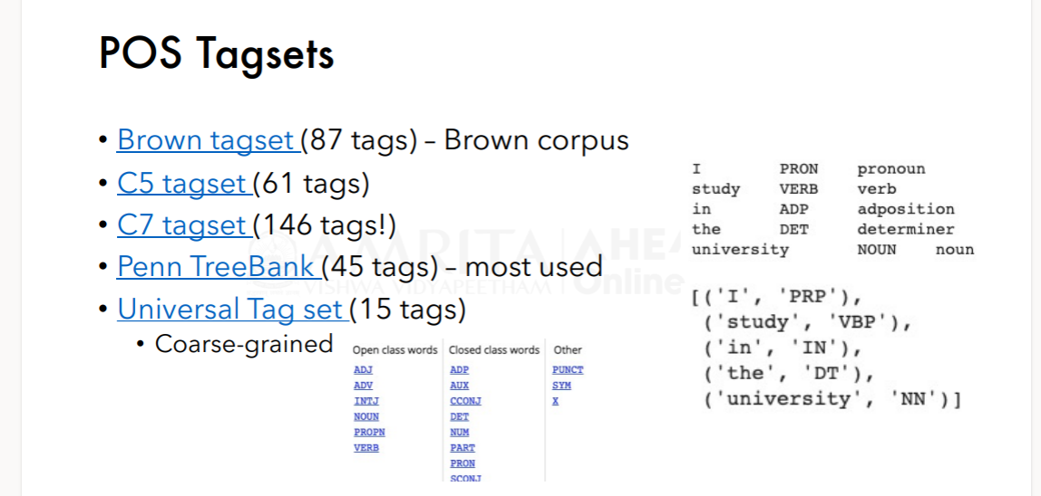

Slide 26
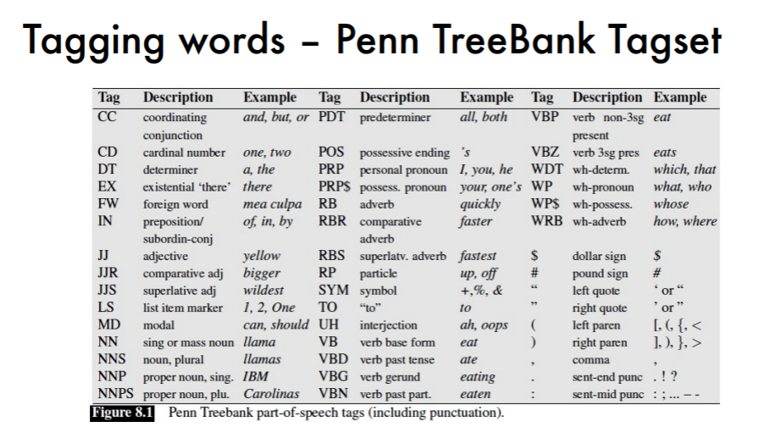

Slide 27
Introduction
The purpose of semantic analysis is to draw exact meaning, or you can say dictionary meaning from the text.
The work of semantic analyzer is to check the text for meaningfulness.
Lexical analysis is based on smaller token but on the other side semantic analysis focuses on larger chunks.
That is why semantic analysis can be divided into the following two parts −
Studying meaning of individual word
Studying the combination of individual words

Slide 28
WordNet
WordNet is a lexical database for the English language, which was created by Princeton, and is part of the NLTK corpus. We can use Wordnet to find the meanings of words, synonyms, antonyms, and more.
Synset is a special kind of a simple interface that is present in NLTK to look up words in WordNet. Synset instances are the groupings of synonymous words that express the same concept

Slide 29
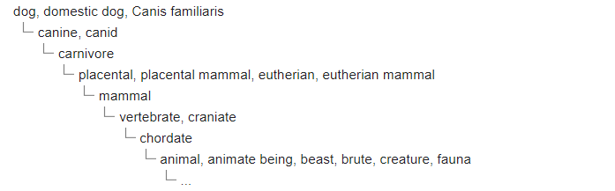
Knowledge structure
Both nouns and verbs are organized into hierarchies, defined by hypernym or IS A relationships.
For instance, one sense of the word dog is found following the hypernym hierarchy.

Slide 30
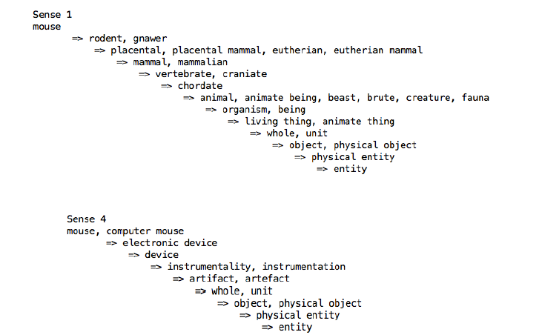
Knowledge structure

Slide 31
Elements of Semantic Analysis
Hyponymy
Homonymy
Polysemy
Meronymy
Hypernymy
Usind wordnet, we can identify all these word relations

Slide 32
Hyponymy
It may be defined as the relationship between a generic term and instances of that generic term.
Here the generic term is called hypernym and its instances are called hyponyms.
For example, the word color is hypernym and the color blue, yellow etc. are hyponyms.

Slide 33
Homonymy
It may be defined as the words having same spelling or same form but having different and unrelated meaning.
For example, the word “Bat” is a homonymy word because bat can be an implement to hit a ball or bat is a nocturnal flying mammal also.

Slide 34
Polysemy
Polysemy is a Greek word, which means “many signs”.
It is a word or phrase with different but related sense.
In other words, we can say that polysemy has the same spelling but different and related meaning.
For example, the word “bank” is a polysemy word having the following meanings −
A financial institution.
The building in which such an institution is located.
A synonym for “to rely on”.

Slide 35
Difference between Polysemy and Homonymy
Both polysemy and homonymy words have the same syntax or spelling.
The main difference between them is that in polysemy, the meanings of the words are related but in homonymy, the meanings of the words are not related.
For example, if we talk about the same word “Bank”, we can write the meaning ‘a financial institution’ or ‘a river bank’.
In that case it would be the example of homonym because the meanings are unrelated to each other.

Slide 36
Synonymy
It is the relation between two lexical items having different forms but expressing the same or a close meaning.
Examples are ‘author/writer’, ‘fate/destiny’.

Slide 37
Antonymy
It is the relation between two lexical items having symmetry between their semantic components relative to an axis.
The scope of antonymy is as follows −
Application of property or not − Example is ‘life/death’, ‘certitude/incertitude’
Application of scalable property − Example is ‘rich/poor’, ‘hot/cold’
Application of a usage − Example is ‘father/son’, ‘moon/sun’.

